Slide 1



Noida Institute of Engineering and Technology, Greater Noida
Problem Solving using Python
Unit: 1
Problem Solving using Python
Ritesh Kumar Singh
NIET Gr. Noida
Computer Science
B. Tech. 1st Sem

Slide 2
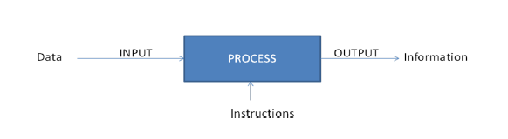
What is Computer?(CO1)
Computer - The term computer is derived from the term “compute”. “Computer is a programmable electronic device that takes data and instruction as an input from the user and, process data, and provides useful information”.

Slide 3
Some keys term that are frequently used in computer (CO1)
Data is unprocessed facts and figures without any added interpretation or analysis.
For e.g. “The price of crude oil is $80 per barrel”.
Information is data that has been interpreted so that it has meaning for the user.
For e.g. “The price of crude oil has risen from $70 to $80 per barrel”.
Instruction Commands given to the computer that tells what it has to do are instruction
Programs A set of instruction that tell what is has to do are instruction
Software A set of program is called software.
Hardware A computer and all physical parts are known as hardware

Slide 4
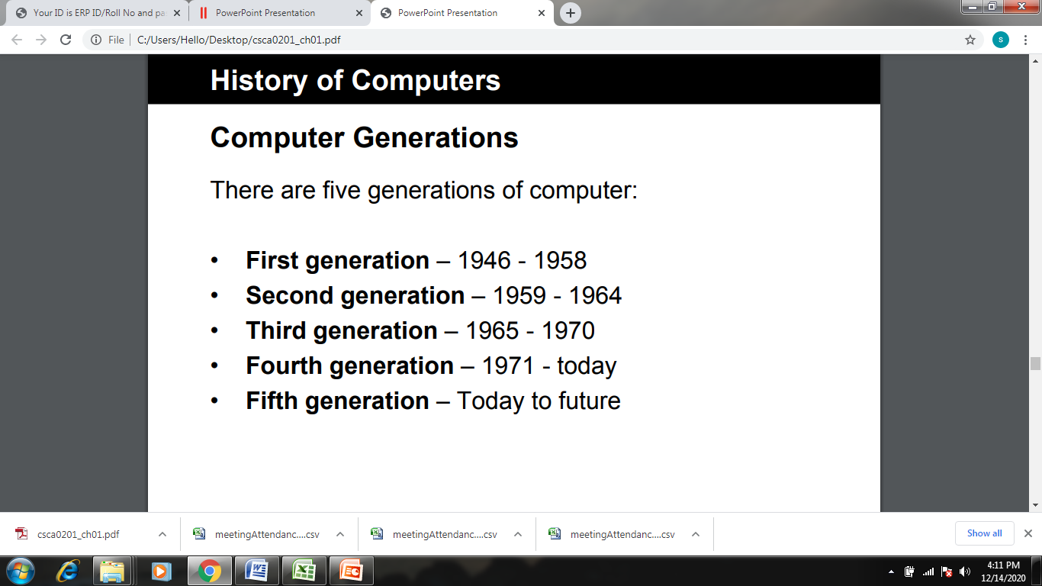
History Of Computers

Slide 5
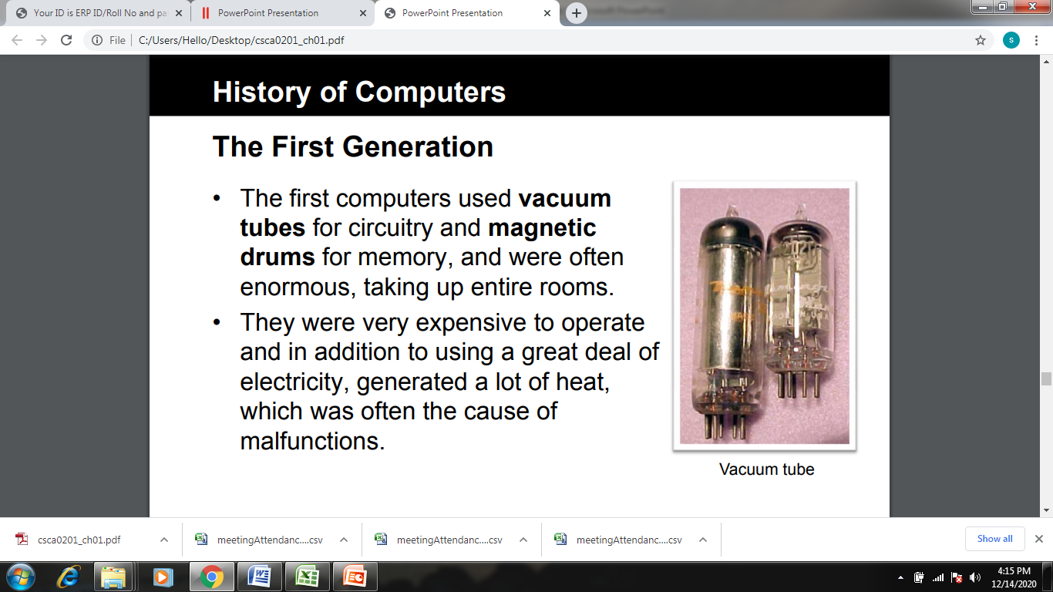
History Of Computers

Slide 6
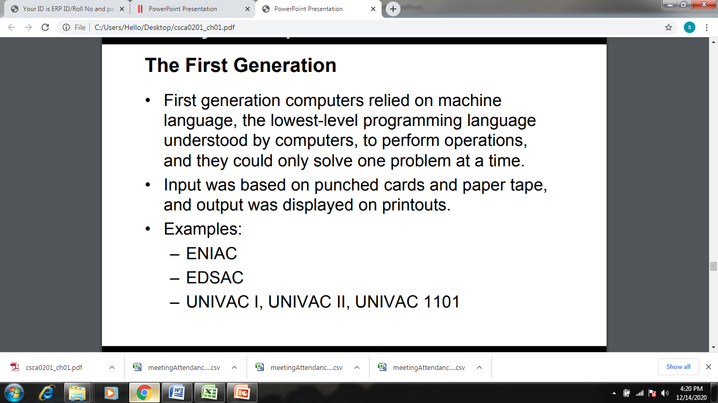
History Of Computers

Slide 7
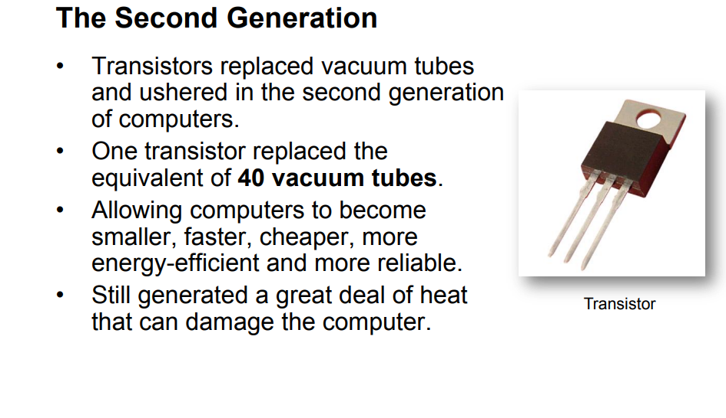
History Of Computers

Slide 8
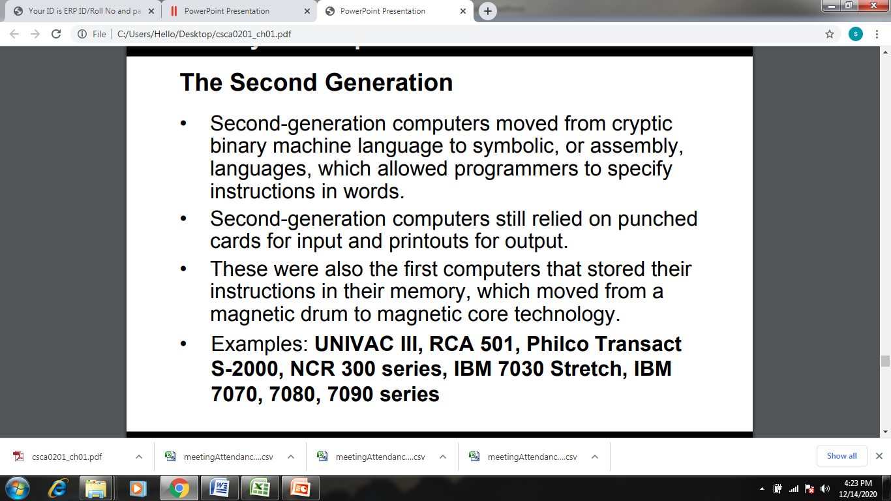
History Of Computers

Slide 9
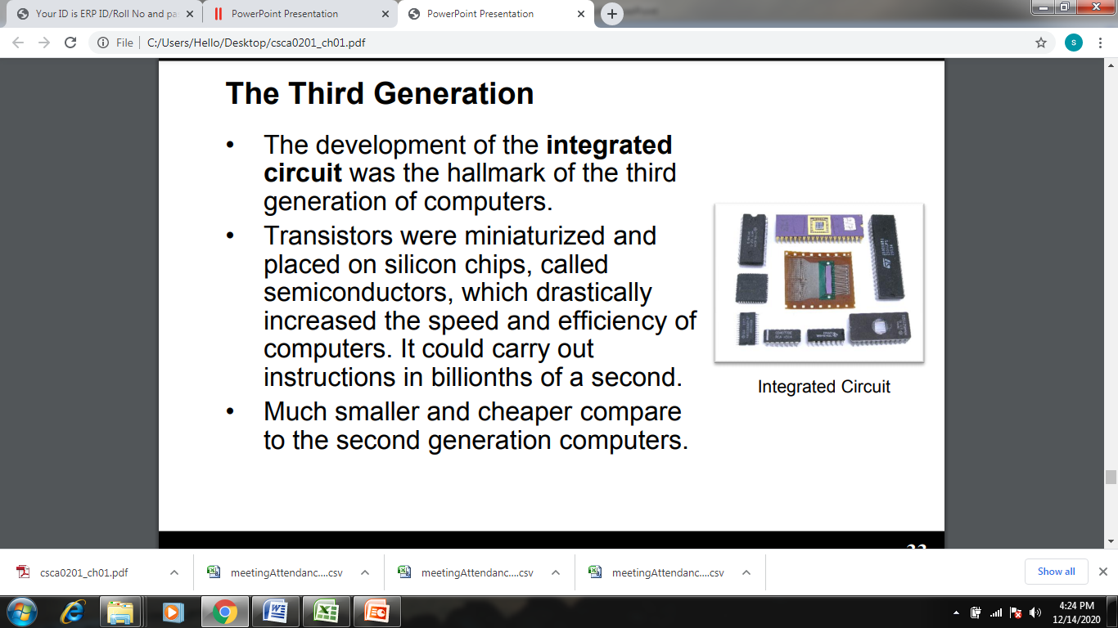
History Of Computers

Slide 10
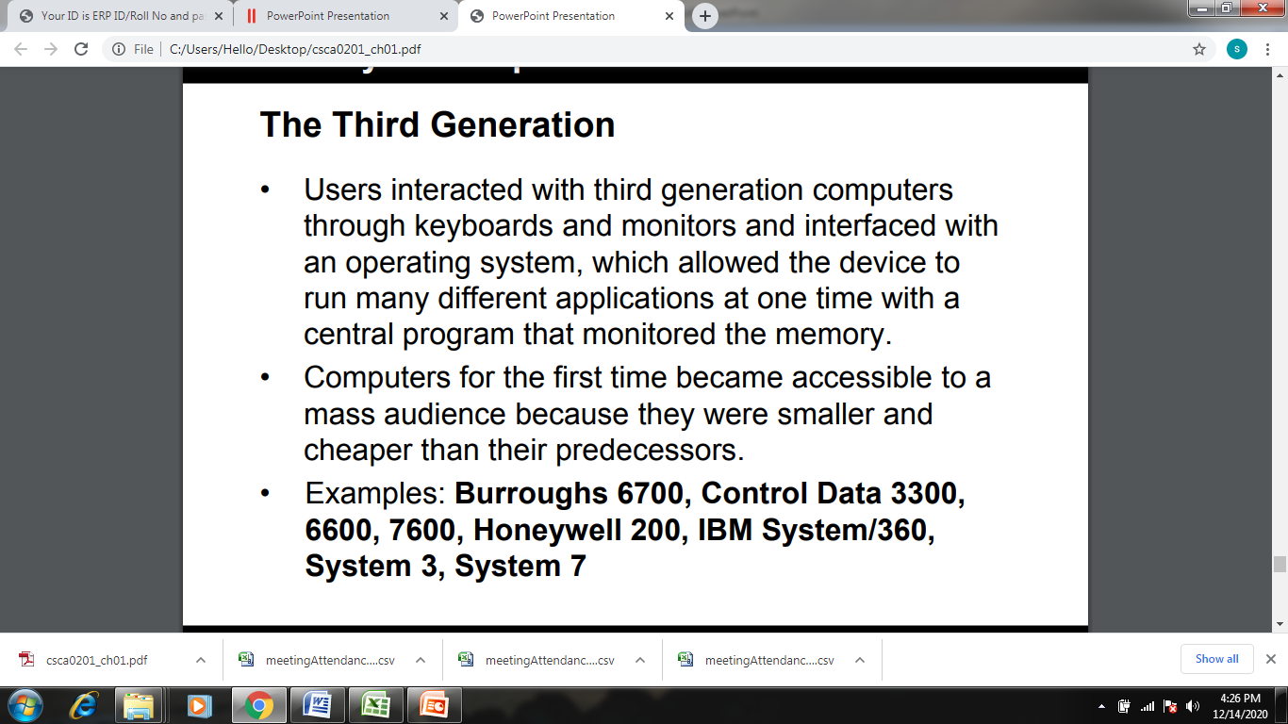
History Of Computers

Slide 11
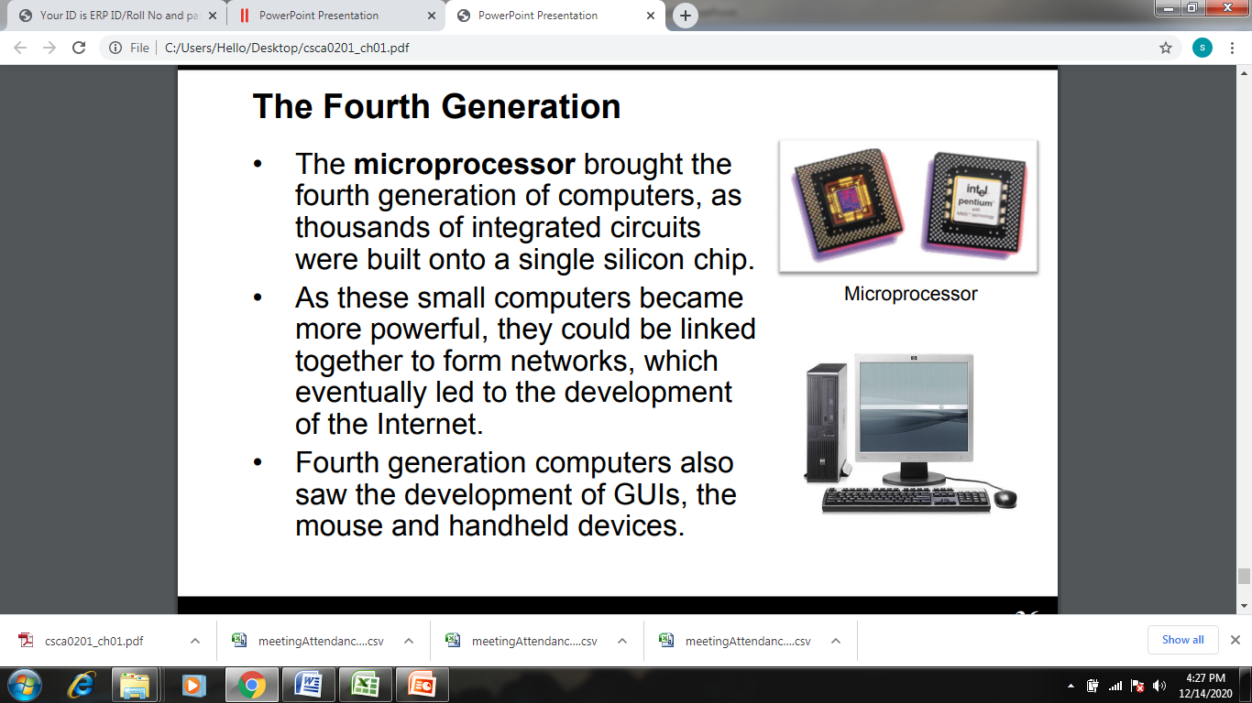
History Of Computers

Slide 12
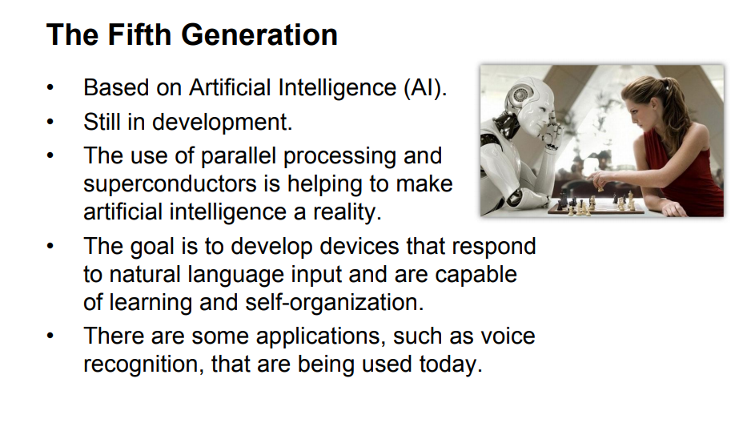
History Of Computers

Slide 13
Characteristics of a Computer(CO1)
Speed - A computer is a fast device. A powerful computer is capable of performing several billions of arithmetic operations per second.
Accuracy - Computers are accurate and depends upon its design.
Diligence - It is free from monotony, tiredness and lack of concentration.

Slide 14
Characteristics of a Computer (Contd.) (CO1)
Versatility - A computer is capable of performing almost any task, if the table can be reduced to a series of logical steps.
Storage - A computer can store and recall any amount of information because of its secondary storage capability.
Automation - It works on a problem without any human intervention. Once it started on a job, they carry on, until the job is finished.

Slide 15
Characteristics of a Computer (Contd.) (CO1)
No Feelings - Computers have no emotion.
No I.Q. - It possesses no intelligence of its own. Its IQ (intelligence quotient) is zero at least until today.

Slide 16
Applications of Computers(CO1)
Word Processing
Digital Audio/Video Compression
Internet
Desktop Publishing
Traffic Control
Retail Business
Hospitals
Business and Industry

Slide 17
Applications of Computers (Contd.) (CO1)
Weather Forecasting
Education
Online Banking
Robotics
Expert Systems

Slide 18
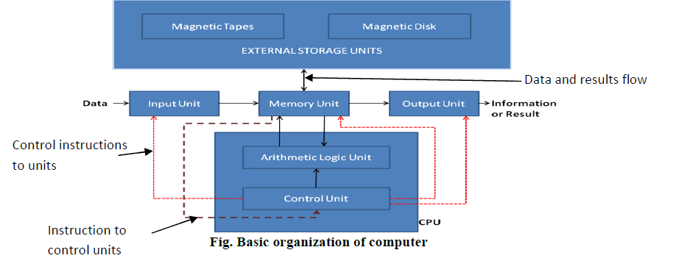
Block Diagram of Digital Computers(CO1)

Slide 19
Components of computer(CO1)
1. Input Devices -
It accepts the instruction and data from the outside world.
It converts these instruction and data in computer acceptable form.
It supplies the converted instructions and data to the computer system for further processing.
Examples are Keyboard, Mouse, Scanner, Touch Screen, Joystick, Bar Code Reader, OMR (Optical Mark Recognition), MICR (Magnetic ink character recognition)

Slide 20
Components of computer (Contd.) (CO1)
2. Output Devices -
It accepts the results produced by the computer coded form.
It converts these coded results to human understandable form.
It supplies the converted result to the outside world.
Examples are Monitors, Printers, Speakers, Projectors, Plotters

Slide 21
Components of computer (Contd.) (CO1)
3. Memory unit -
It stores the data and instructions required for processing and stores intermediate results of processing.
It also stores the final results of processing, before these results are released to an output device.
It is mainly of 2 types –
Primary storage
Secondary storage.

Slide 22
Components of computer (Contd.) (CO1)
4. CPU (Central Processing Unit) -
It is the brain of a computer system. It is responsible for activating and controlling the operations of other units of the computer system.
It consists of –
Control unit (CU)
Arithmetic Logic Unit (ALU)

Slide 23
Components of computer (Contd.) (CO1)
Control Unit -
It manages and coordinate entire computer system. It obtains instructions from program stored in main memory, interprets the instructions, and issues signals, which cause other units of the system to execute them.
Arithmetic Logic Unit (ALU) -
It is the place where actual execution of the instructions takes place, during the processing operation. The data and instructions stored in the primary storage before processing, are transferred as when needed to the ALU. Processed data is transferred back to the main storage.

Slide 24
Daily Quiz 1
Complete this equation: Data + _________________ = Information
Answer: Meaning
These are raw facts, figures, values or instructions with no specific meaning by themselves.
(a) Information
(b) Data
(c) Meaning
Answer: b

Slide 25
Daily Quiz 1 (Contd.)
The basic architecture of computer was developed by -
A.John Von Neumann B.Charles Babbage
C.Blaise Pascal D.Garden Moore
Answer: B
The basic operations performed by a computer are A) Arithmetic operation B) Logical operation C) Storage and relative D) All the above
Answer: D

Slide 26
Topic Objective
After you have read and studied this topic, you should be able to
Understand the concept of computer program
Understand programming language
Understand the difference between machine language and High-level language
Understand the concept of assembly language

Slide 27
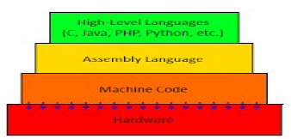
Type of Computer Languages (CO1)
• Machine Language
• Assembly Language
• High level Language

Slide 28
Machine Language (CO1)
Machine language is a collection of binary digits or bits that the computer reads and interprets.
• It is a low-level language.
• Instructions written in the form of 0 and 1.
• Machine language is the only language a computer is capable of understanding.
• Sometimes referred to as machine code or object code.
• Communicate directly with the computer.
Advantages
Computation speed is very fast.
Directly understandable by computer.
Disadvantages
Writing a program is very time consuming.
Error correction is a tedious process.

Slide 29
Assembly Language (CO1)
• It is also a low-level language.
• Written in the form of symbolic codes (mnemonics).
• Symbolic codes are like- ADD, SUB, MUL, DIV, LOAD, STORE, etc.
• Each assembly language is specific to a particular computer architecture.
• Assembly language is converted into executable machine code by a utility program referred to as an assembler.
Advantages
• Easier to understand as compared to machine code.
• Easy to locate and correct errors.
Disadvantages
• Like machine language it is also machine dependent.
• Programmer should have knowledge of hardware.

Slide 30
High Level Language (CO1)
A high-level language is a programming language that enables a programmer to write programs that are more or less independent of a particular type of computer.
• It is much closer to human language.
• It uses English words and/or mathematical notations.
Examples: COBOL, FORTRAN, PASCAL, C, C++, JAVA etc.
Advantages
• User-friendly. • Easier to learn.
• Require less time to code. • Easier to maintain.
Disadvantages
• Slower than low level language.
• Needs a translator.

Slide 31
Differentiate among Machine, Assembly and High level languages(CO1)
High level Language | Assembly Language | Machine Language
Programs of these languages are easily understandable. | These are less understandable than high level languages and more understandable than machine language. | Programs are less understandable
Programs of these languages are easily understandable. | These are less understandable than high level languages and more understandable than machine language. | Programs are less understandable.
Programs are portable and machine independent | Programs are machine dependent. | Programs are machine dependent.
In this language debugging is easier. | Debugging is more complex than high level languages. | Debugging is very difficult
Compiler or Interpreter is required to translate the program. | Assembler is required to translate the program | No translation is required

Slide 32
Generations of Programming Languages(CO1)
1GL - Machine language.
2GL - Assembly language.
3GL - High level language (C, C++, JAVA, BASIC) (Procedural/object-oriented)
4GL - Structured Query languages (SQL).
5GL - Logic languages (LISP)

Slide 33
Topic Objective
After you have read and studied this topic, you should be able to
Understand the concept of translator, compiler, interpreter and assembler
Understand the steps required in program execution
Understand the concept of linker and loader
Understand the difference between object code and executable code

Slide 34
Translators (CO1)
A translator is a software that translate any programming language to another programming language.
There are following three translators :
– Assembler
– Compiler
– Interpreter

Slide 35
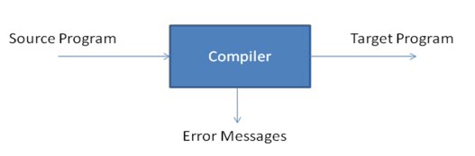
Compiler (CO1)
• Compiler is a special type of program that translate the source code written in high level language (source language) into the low-level language (target language).
• The resultant code can be assembly code or the object code. It is used to create an executable program.
• It locates and reports syntax error in the program (if any). But it cannot fix the error by itself.

Slide 36
Assembler (CO1)
• It is a special program that translate the code written in assembly language into an equivalent code in machine language.
• The result is the object file that can be executed.

Slide 37
Interpreter (CO1)
• An interpreter is a computer program that directly executes without previously compiling them into a machine language program.
• It converts High level language into low level.
Interpreter is one which converts a source program and executes it at the same time.
• It translates line by line.

Slide 38
Difference between Interpreter and Compiler(CO1)
Interpreter | Compiler
Translated program one statement at a time | Scans the entire program and translates it as a whole into machine code
Takes less amount of time to analyze the source code but overall execution time is slower | Takes large amount of time to analyze the source code but overall execution time is comparatively faster.
No intermediate code generated | Generate intermediate code
Requires less memory | Requires more memory
Debugging is easy | Debugging is comparatively hard

Slide 39
Topic Objective
After you have read and studied this topic, you should be able to
Understand the concept of algorithm and flowchart
Design algorithm for real-life problems
Convert algorithm into flowchart

Slide 40
Algorithm (CO1)
An algorithm is a sequence of computational steps that transform the input into the output.
An algorithm provides step by step solution of given problem.

Slide 41
Properties of good Algorithm /Characteristics of algorithm (CO1)
An algorithm must have the following properties:
Input : An algorithm required input from the user
Output: An algorithm gives at least one output.
Definiteness: Each step must have a unique defined preceding and succeeding step.
finiteness: An algorithm should be terminated in finite no of steps
Effectiveness: Each step must be effective i.e. it should be easily convertible into program

Slide 42
Flow Chart(CO1)
Flow chart is a graphical representation of a process. Each step in the process is represented by different symbols and contains the short description of the process step.
Flow Chart Symbols:
Terminator: Terminator symbol is used to represent the beginning and end of a process.
Process: Process symbol is used to represent an activity.
Data: A data symbol is used to represent input and output in a flow chart.
Decision: A diamond shape is used to show the decision.
Connector Lines: Connector lines are used to connect the symbols in a flow chart. The direction of arrow indicates the next step.

Slide 43
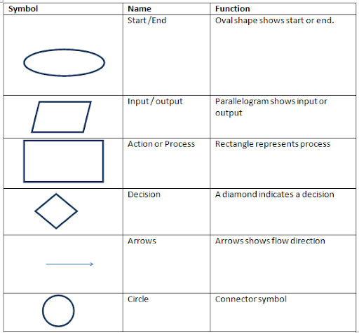
Flow Chart Symbols(CO1)

Slide 44
Pseudo Code(CO1)
Pseudocode is an informal high-level description of the operating principle of a computer program.
It uses the basic syntax of a normal programming language.
It is human readable rather than machine readable.

Slide 45
Difference between Algorithm and Flow Chart(CO1)
Algorithm | Flow Chart
1. An algorithm is step by step procedure to solve a given problem. | 1. Flow chart is pictorial representation of the flow of the program.
2. It is very easy procedure to represent logics in algorithm. | 2. It is very complex to represent some logic's using flow chart due to lack of more symbols.
3. It is easy to modify algorithm. | 3. It is very difficult to modify flow chart.

Slide 46
Difference between Algorithm and Pseudocode(CO1)
Algorithm | Pseudocode
1. An algorithm is a well-defined sequence of steps that provides a solution for a given problem. | 1. A pseudocode is one of the methods that can be used to represent an algorithm.
2. An algorithm can be written in natural language | 2. Pseudocode is written in a format that is closely related to high level programming language.
3. Transforming an algorithm in to programming code is difficult. | 3. Converting a pseudo code in to programming code is easy.

Slide 47
Algorithm to find the sum of two numbers(CO1)
Step-1 Start
Step-2 Input first numbers say A
Step-3 Input second number say B
Step-4 SUM = A + B
Step-5 Display SUM
Step-6 Stop

Slide 48
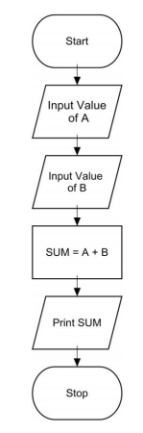
Flowchart to find the sum of two numbers(CO1)

Slide 49
Algorithm to convert temperature from Celsius to Fahrenheit (CO1)
C : temperature in Celsius
F : temperature Fahrenheit
Algorithm
Step-1 Start
Step-2 Input temperature in Celsius say C
Step-3 F = (9.0/5.0 x C) + 32
Step-4 Display Temperature in Fahrenheit F
Step-5 Stop

Slide 50
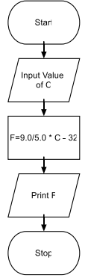
Flowchart to convert temperature from Celsius to Fahrenheit(CO1)

Slide 51
Algorithm to find the smallest of two numbers(CO1)
Step-1 Start
Step-2 Input two numbers say NUM1,NUM2
Step-3 IF NUM1 < NUM2 THEN
print smallest is NUM1
ELSE
print smallest is NUM2 ENDIF
Step-4 Stop

Slide 52
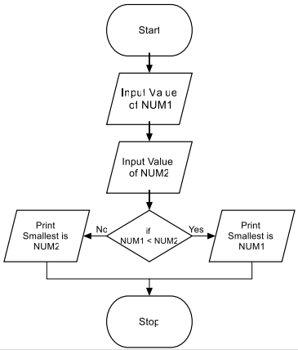
Flowchart to find the smallest of two numbers(CO1)

Slide 53
Algorithm to print multiplication Table of a number(CO1)
Step-1 Start
Step-2 Input Value of NUM
Step-3 I = 1
Step-4 IF (I >10) THEN
GO TO Step 9
ENDIF
Step-5 PROD = NUM * I
Step-6 WRITE I “x” NUM “=” PROD
Step-7 I = I + 1
Step-8 Go to step-4
Step-9 Stop

Slide 54
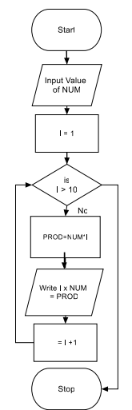
Flowchart to print multiplication Table of a number(CO1)

Slide 55
Daily Quiz 5
What do you mean by High-level and low-level programming language?
Define compiler, interpreter and assembler.
Explain object code and executable code with example.
Write down algorithm to find sum of digits of a given number.
Explain Flowchart and symbols used in the flowchart.
Draw flow chart to check given number is palindrome or not.
write an algorithm and draw flowchart to check year is leap year or not

Slide 56
Weekly Assignment 2
Que 1 – Covert the following :
(a) [10111001.0111]₂ = [ ]₁₀
(b) [582]₁₀ = [ ]₁₆
(c) [2547]₈ = [ ]₂
(d) [78D1]₁₆ = [ ]₂
Que 2 - What is translator? Explain compiler, assembler,
interpreter in detail.
Que 3 – Differentiate between Machine language, Assembly language
and high-level programming language.
Que 4 – Write algorithm and draw a flowchart to check that enter
number is even or odd.
Que 5 - Draw a flowchart to print the sum of sequence of alternative numbers between 1 to n.

Slide 57
You tube & NPTEL Video Links
Youtube/NPTEL Video Links –
https://nptel.ac.in/courses/106/105/106105171/
https://nptel.ac.in/courses/106/104/106104128/
https://www.youtube.com/channel/UC5o8kz8aQHIiFk23sJ9pxig

Slide 58
MCQs
1. Which is referred to the brain of computer? A: Processor B: RAM
C: ROM D: Hard drive
Answer 1 : a
2. What is the name of programs that control the computer system?
A: Hardware B: Keyboard
C: Software D: Mouse
Answer 2 : c

Slide 59
MCQs
3. What is the common measurement of unit of a computer memory?
A: IQ B: Byte
C: Terabyte D: Gigabyte
Answer 3 : b
4. The decimal equivalent of (0.101)2 will be ____________
a) 0.5 b) 0.625
c) 0.25 d) 0.875
Answer 4 : b

Slide 60
MCQs
5. The program written by the programmer in high level language is called __________
a) Object Program b) Source Program
c) Assembled Program d) Compiled Program
Answer 5 : b
6. Which of the following is the fastest means of memory access for CPU?
a) Registers b) Cache
c) Main memory d) Virtual Memory
Answer 6: a

Slide 61
MCQs
7. These devices provide a means of communication between a computer and outer world.
a) I/O b) Storage
c) Compact d) Drivers
Answer 7: a
8. What does GUI stand for?
a) Graphical User Instruction
b) Ground User Interface
c) General User Instruction
d) Graphical User Interface
Answer 8: d

Slide 62
MCQs
9. When an algorithm is written in the form of a programming language, it becomes a _________
a) Flowchart b) Program
c) Pseudo code d) Syntax
Answer 9: b
10. In computer science, algorithm refers to a pictorial representation of a flowchart.
a) True b) False
Answer 10: b

Slide 63
Old University Exam Question Papers
Que – Draw the block diagram of a computer system. Explain its
different components with suitable example.
[AKTU 2018-19 (Even) Marks-10]
Que – Write an algorithm and draw a flowchart to find the sum of digits of an integer number entered by the user.
[AKTU 2018-19 (Even) Marks-10]
Que – Write an algorithm and draw a flowchart to reverse an
integer number entered by the user.
[AKTU 2018-19 (Even) Marks-10]
Que - Discuss the concept of assembler. Explain complier, interpreter, loader and linker with example.
[AKTU 2018-19 (Even) Marks-10]

Slide 64
Old University Exam Question Papers
Que – Describe the basic components of a computer system with neat and clean block . What do you mean by operating system? Explain. [AKTU 2018-19 (Odd) Marks-10]
Que – What is algorithm? What are the main steps followed in the development of an algorithm? Write an algorithm for sum of digits in a given number.
[AKTU 2017-18 (Even) Marks-07]
Que – Describe Compiler, interpreter, assembler? Write the names of compiler that are used in c programming.
[AKTU 2017-18 (Even) Marks-07]
Que – Differentiate complier and interpreter.
[AKTU 2017-18 (odd) Marks-02]

Slide 65
Old University Exam Question Papers
Que – Convert the following:
(i) (0110110.1100)2 = ()8
(ii) (74.67)10 = ()16
(iii)(AB.CD)16 = ()8
(iv)(EFE.45)16 = ()2
(v) (576.4)10 = ()6
(vi)(1234.7)8 = ()16
(vii)(334.43)8 = ()2
[AKTU 2017-18 (Even) Marks-07]

Slide 66
Expected Questions for University Exam
Draw the block diagram of a digital computer system. Explain its different components with suitable example.
Explain memory hierarchy with suitable diagram.
What is Operating System? Explain functions and types of operating system in detail.
Describe Compiler, interpreter, assembler? Also differentiate among them.
Write an algorithm and draw a flowchart to find the greatest among three numbers.
Draw flow chart to check given number is palindrome or not.

Slide 67
Summary
“Computer is a programmable electronic device that takes data and instruction as an input from the user and, process data, and provides useful information”.
Data is unprocessed facts and Information is processed & meaningful data.
CPU is the brain of a computer system. It is responsible for activating and controlling the operations of other units of the computer system.
Computer memory is any physical device capable of storing information temporarily or permanently.

Slide 68
Summary (contd..)
Software is defined as a computer program, which includes logical instructions used for performing a particular task on a computer system using hardware components.
An operating system is a program that acts as an interface between the user and the computer hardware and controls the execution of all kinds of programs.
A computer programming language is a language used to write computer programs, which involve a computer performing some kind of computation or algorithm.
Machine language is a collection of binary digits or bits that the computer reads and interprets.

Slide 69
Summary (contd..)
Assembly language is written in the form of symbolic codes (mnemonics).
A high-level language is a programming language that enables a programmer to write programs that are more or less independent of a particular type of computer.
• Compiler is a special type of program that translate the source code written in high level language (source language) into the low-level language (target language).
Interpreter converts High level language into low level.
An algorithm provides step by step solution of given problem.
Flow chart is a graphical representation of a process.

Slide 70
Thank You

